Slide 1
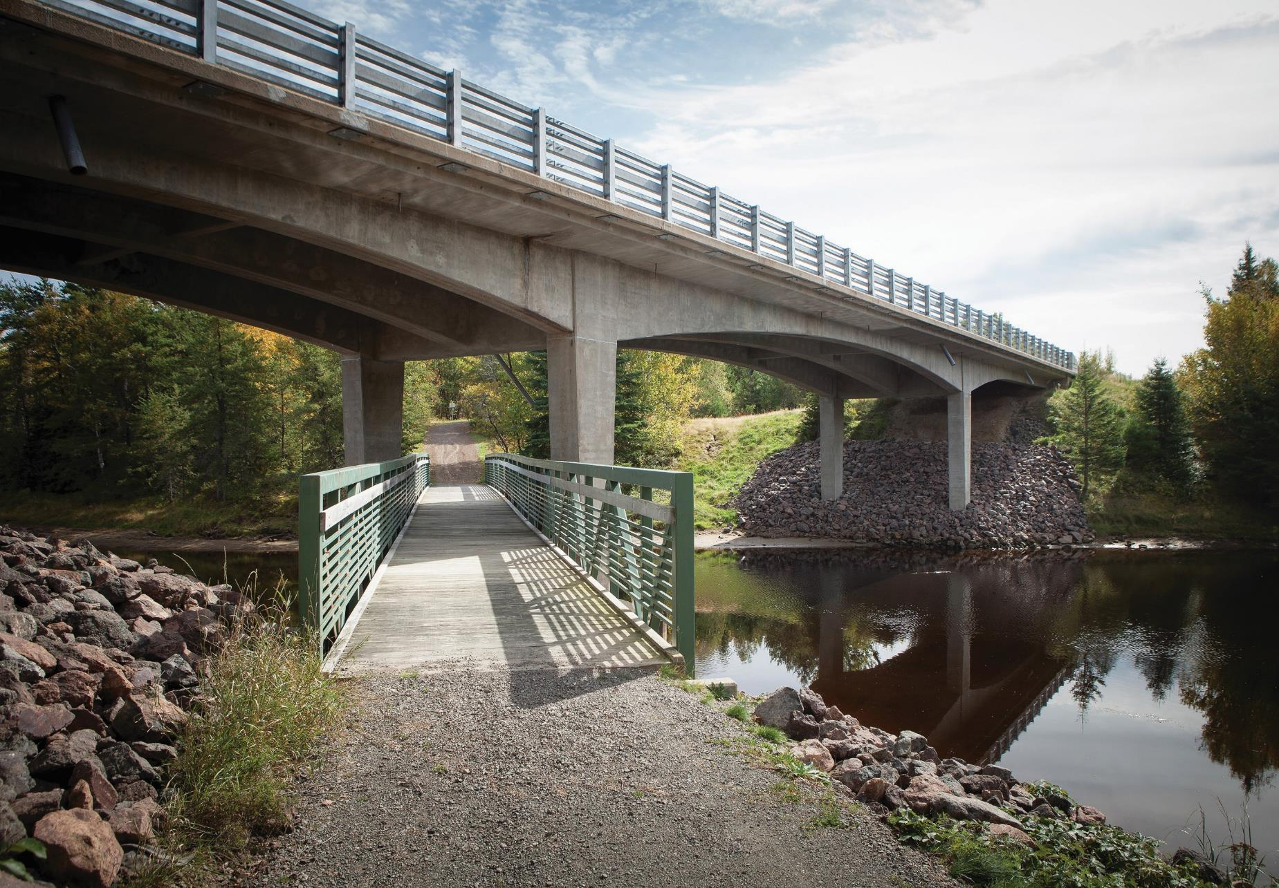

Reducing carbon along the M5 corridor
David Collis

Slide 2
Who are Stantec?

Slide 3

1954
STANTEC FOUNDED
$7.5 billion
2024 REVENUE ($CAD)
34,000
EMPLOYEES GLOBALLY
STN
TRADED ON NYSE & TSX
6
CONTINENTS WE OPERATE IN
450
LOCATIONS WORLDWIDE

Slide 4
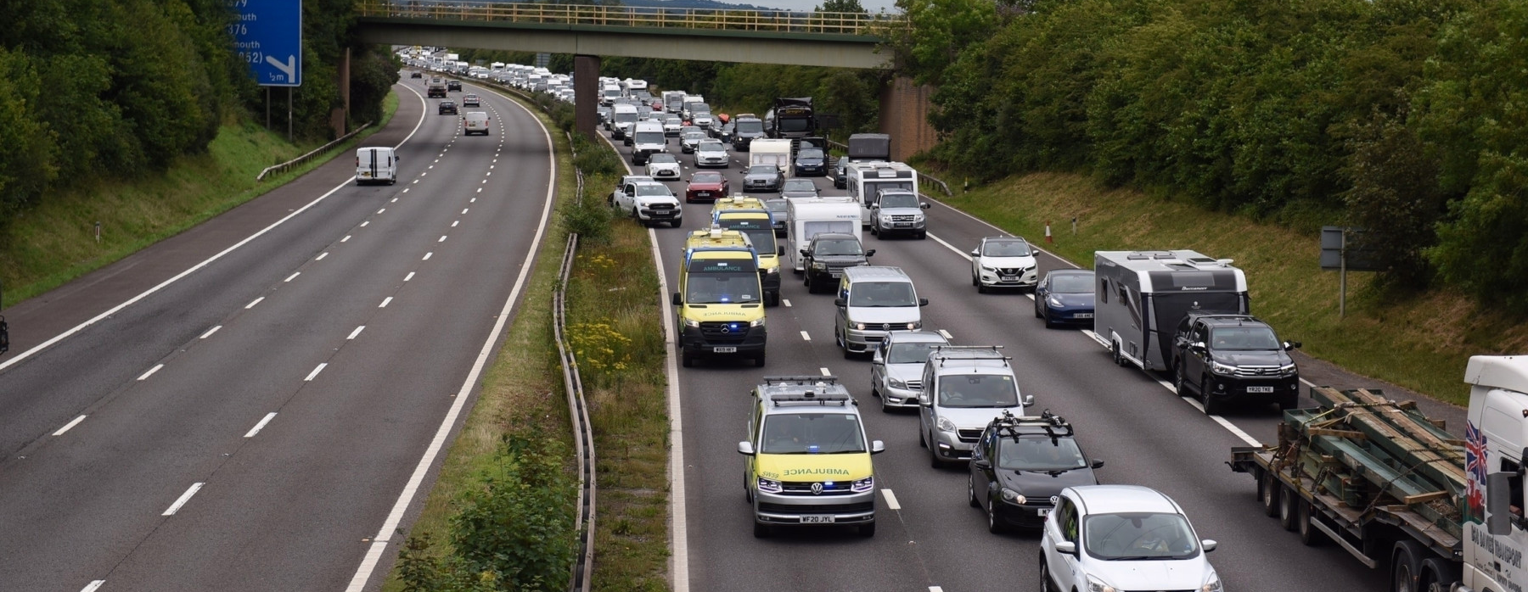
What is the project about?

Slide 5
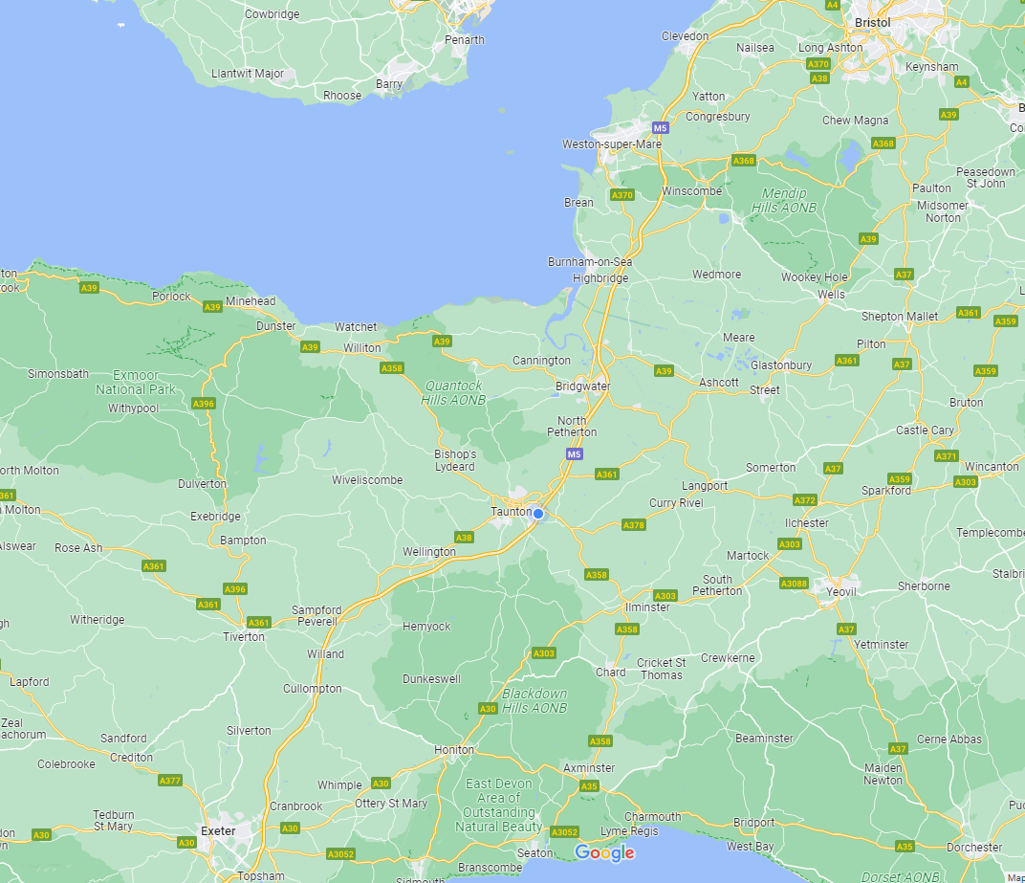
M5 Corridor
The potential to reduce vehicle kilometres on the M5 corridor.
What if people could interchange to a fast bus – who would this benefit – what change could we make

Slide 6
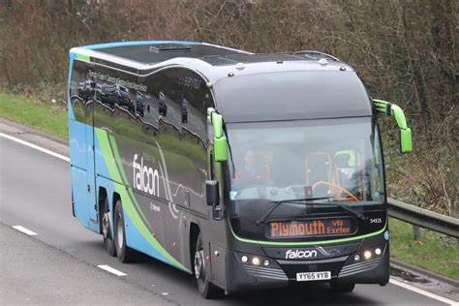
Megabus Falcon
Connects towns along the M5 corridor to Bristol Airport.
Poor local facilities at collection points and no good dedicated feeder services.
What if we had a high-quality service and interchange with feeder services – what is the potential to take cars off the M5 and replace with bus.

Slide 7
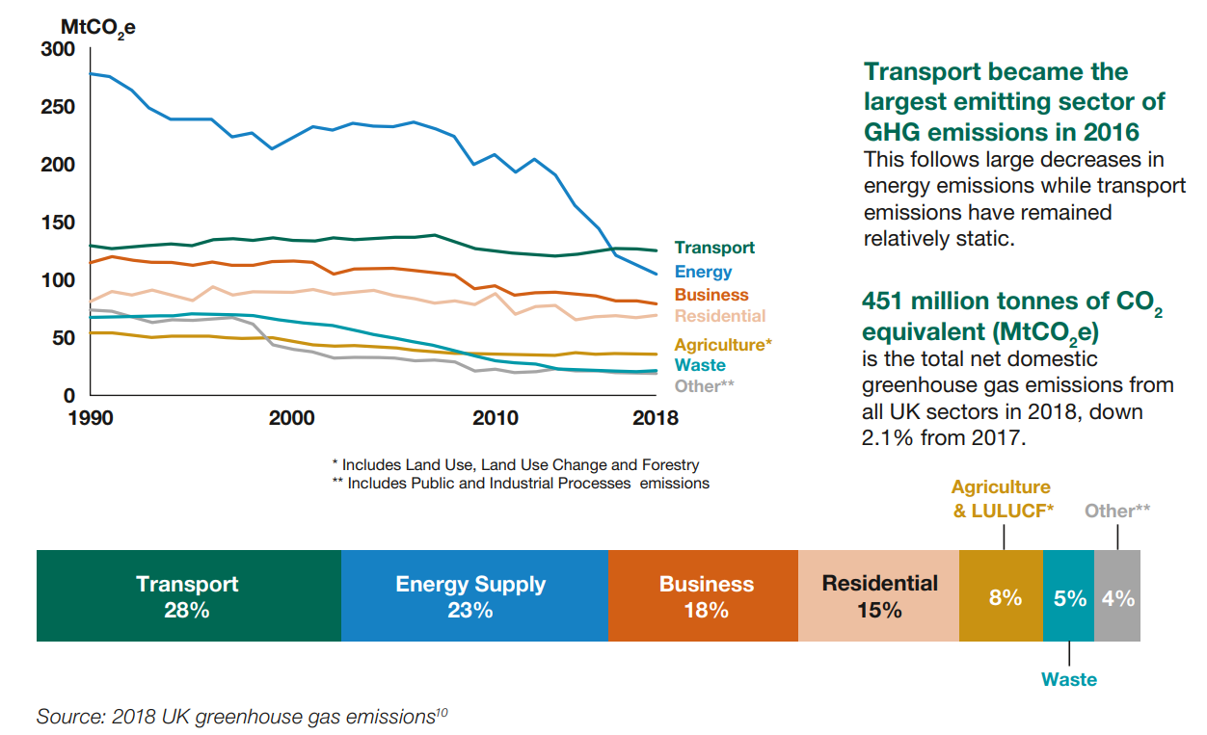
Notes:
Decarbonising Transport: a better greener Britain

Slide 8
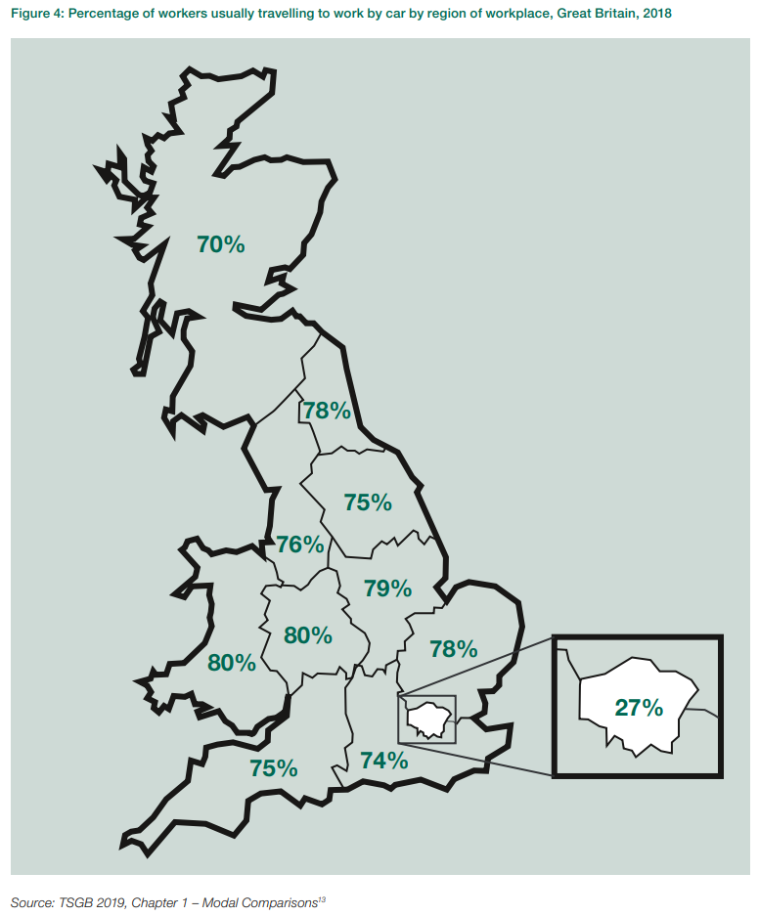
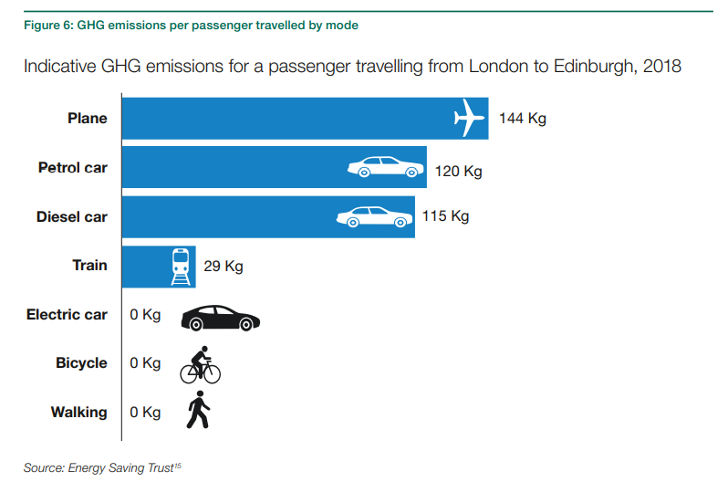

Slide 9
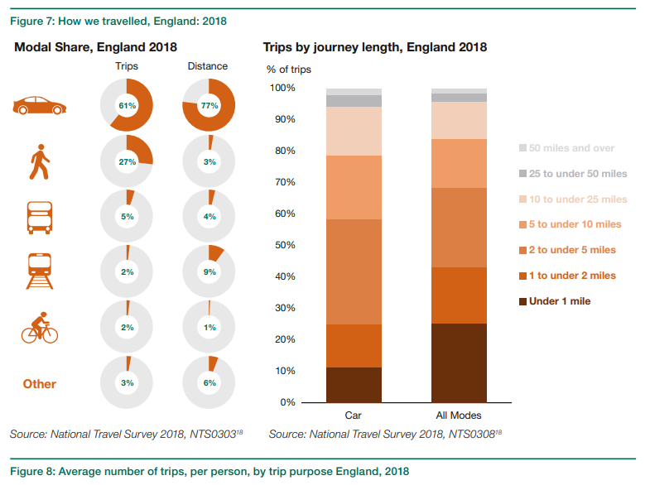

Slide 10
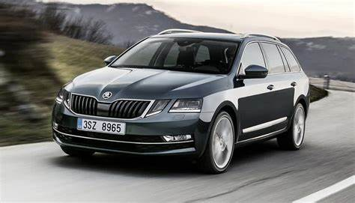
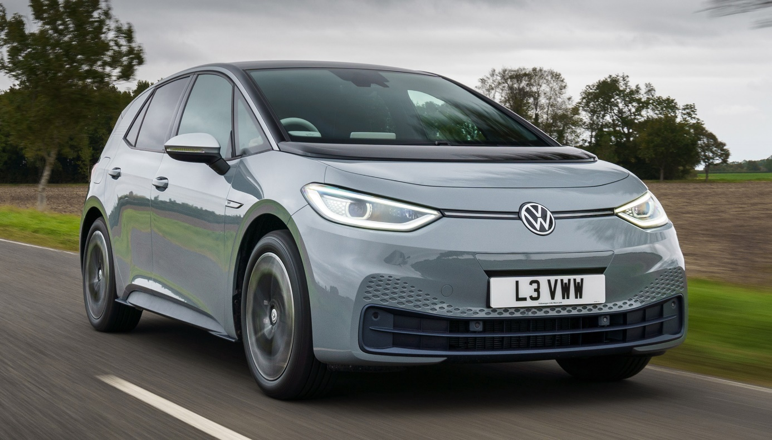
Data versus expectations
According to E-NCAP a 2l diesel Skoda Octavia has a lower lifetime carbon footprint than an all-electric VW ID3.
Manufacturing process is therefore also a large contributor to carbon.
Transition from reliance on cars is key!

Slide 11




Navigating the next industrial revolution
Revolution 01
Revolution 02
Revolution 03
Revolution 04
1784
1870
1969
?
Steam, water, mechanical production equipment
Division of labour, electricity, mass production
Electronics, IT, automated production
Cyber-physical systems

Slide 12
The Project?

Slide 13
Transport Appraisal Guidance (TAG) data book:
https://www.gov.uk/government/publications/tag-data-book
Includes Department for Transport (DfT) forecasts for factors such as GDP, perceived travel costs and vehicle fleet composition (petrol, diesel, & electric).
National Highways (NH) Traffic Counts:
https://webtris.highwaysengland.co.uk/
Shows location of all HE traffic counters (HE covers primarily motorways, dual carriageways, and trunk roads). Individual sites can be selected to view data availability and data can then be downloaded.
2011 Census:
https://www.nomisweb.co.uk/census/2011/data_finder
https://www.nomisweb.co.uk/census/2011/qs701ew
https://www.nomisweb.co.uk/census/2011/dc7701ewla
Table finder provides a list of all summary tables available from the 2011 census. Method of travel to work (Table QS701EW) is an often-used table to analyse mode share for selected area. Also available is Table DC7701EWLA which shows mode of travel to work by distance travelled.
Census Boundaries:
Lower layer Super Output Areas (December 2011) Boundaries EW BFC (V3) | Open Geography Portal
Middle layer Super Output Areas (December 2011) Boundaries EW BFC (V3) | Open Geography Portal
Census boundary information. Data can be downloaded as shapefiles for use in GIS software such as QGIS (free) or ArcGIS (requires license). Links are to Lower Super Output Area (LSOA) and Middle Super Output Area (MSOA). These are geography levels most often used for transport analysis.
National Travel Survey:
https://www.gov.uk/government/statistics/national-travel-survey-2021
https://www.gov.uk/government/statistical-data-sets/ad-hoc-national-travel-survey-analysis
Includes data on travel trends as far back as 2002 including number of trips, travel purpose, and mode choice.
Review Data Sources
Use a range of data sources to obtain an understanding of current movement along the M5 corridor.
Start with looking at different data sources, understand what is included – strengths and limitations of them.
For example, 2011 census data is a good dataset but is now quite old. Some of the 2021 census has just been published but how relevant is this – we were in lockdown at the time.

Slide 14
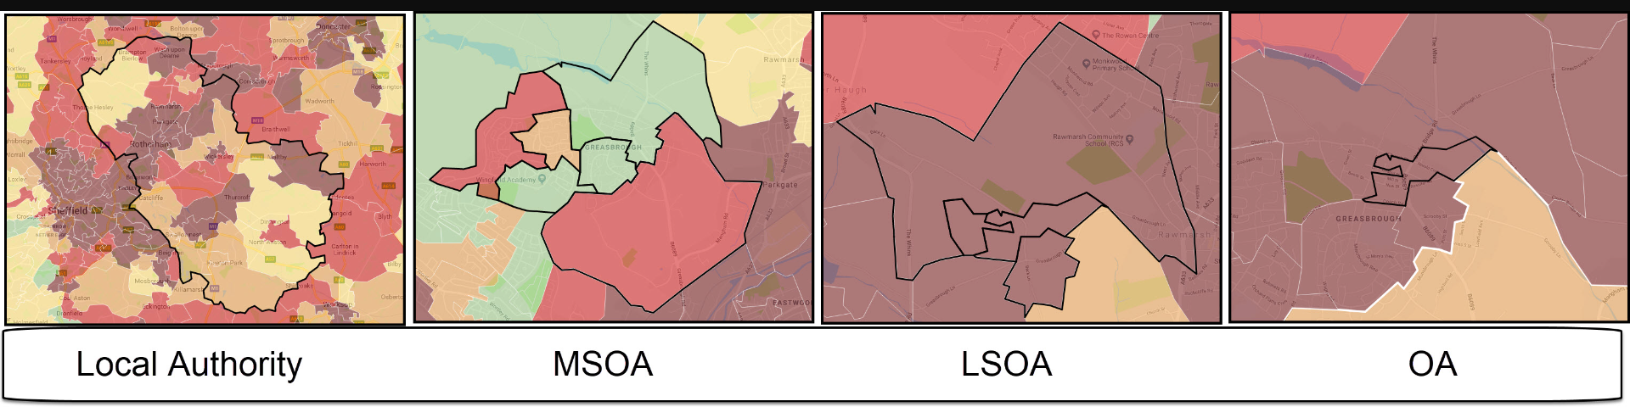
Draft Methodology (1)
MSOA – Middle Layer Super Output Area
(average of 7500 residents)
LSOA – Lower Layer Super Output Area
(average of 1500 residents)
OA – Output area)
(average of 310 residents)
Create a simple zoning system for the M5 corridor and towns and cities along it – this will be based on 2011 Census (Journey to work by mode of transport) areas. e.g. we might see Cullompton as a Zone.

Slide 15
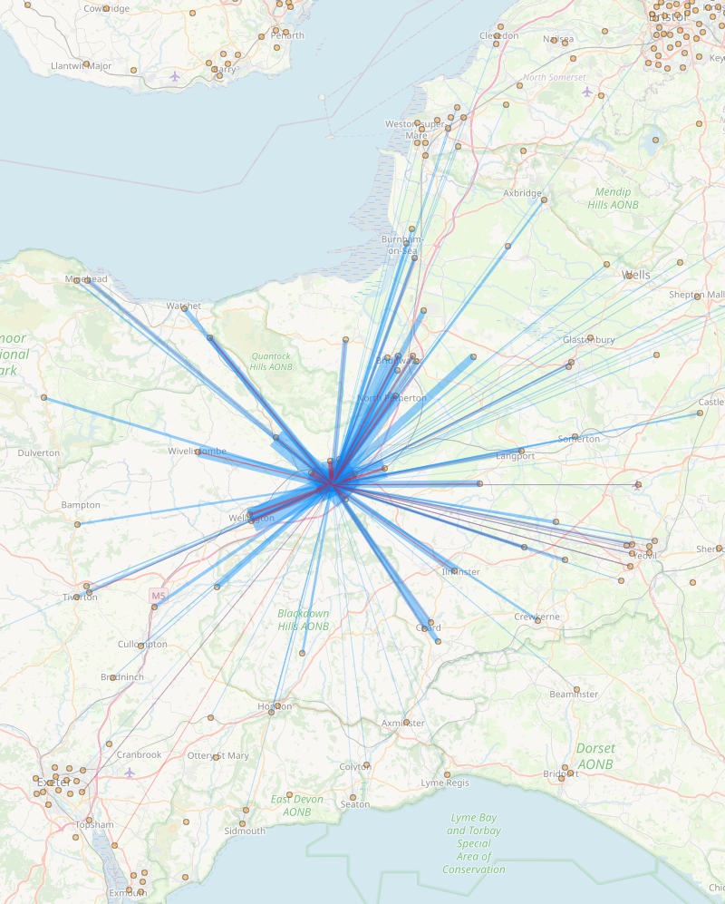
Draft Methodology (2)
Identify the journey to work trips between the key destinations (eg Cullompton to Taunton). This will involve extracting data from NOMIS website and combine the data to match the zones.
https://commute.datashine.org.uk/#mode=allflows&direction=both&msoa=undefined&zoom=11.3&lon=-3.4713&lat=50.7403
DataShine website visualises the 2011 census data.
Image shows commute trips as car driver to / from Taunton

Slide 16
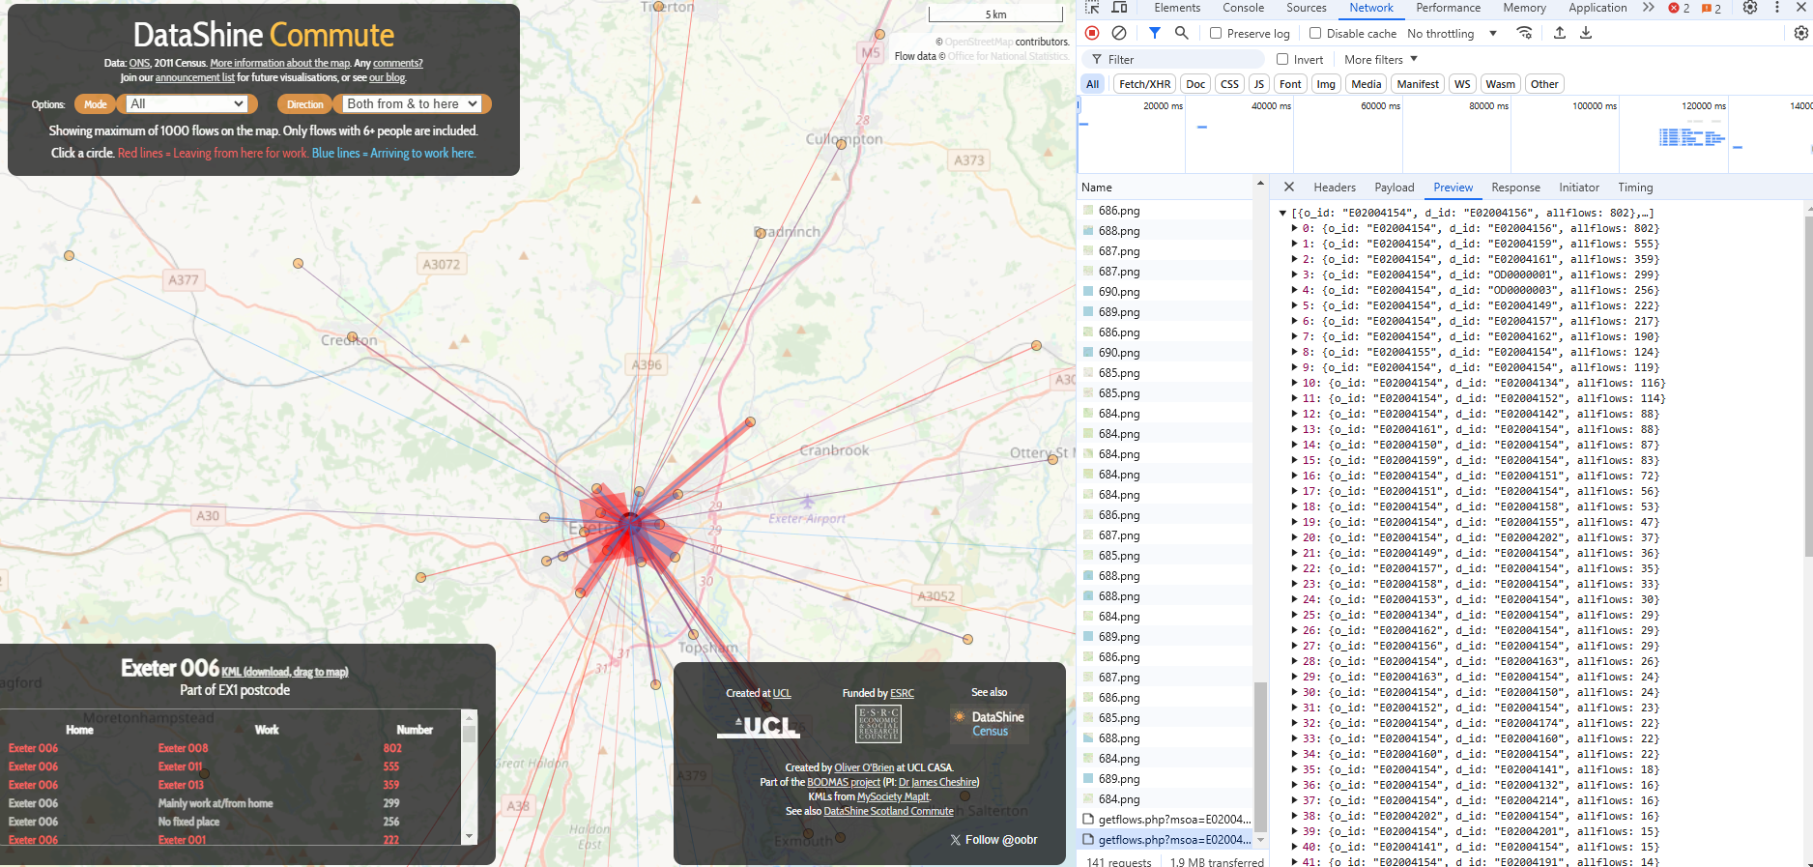
DataShine Tip
Right click on map and click “Inspect”.
Go to Network tab in Inspect window.
When clicking location on map the data will be loaded as per the screenshot.
Data can easily be copied and pasted into Excel / other programs for analysis.

Slide 17
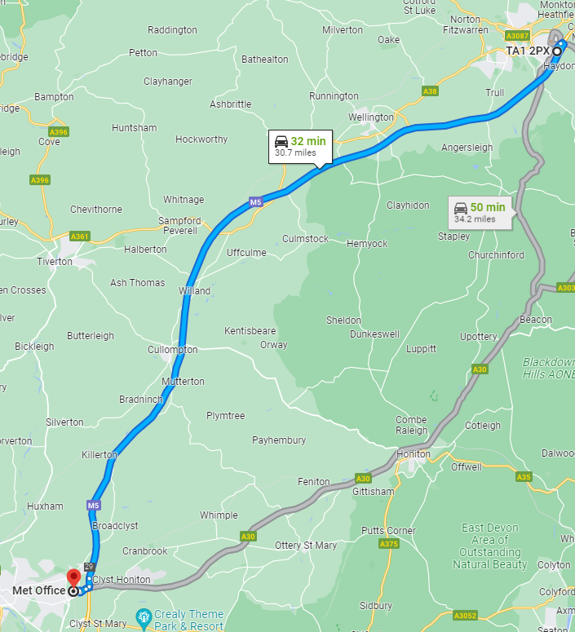
Draft Methodology (3)
Simple process of assigning which trips will be on the motorway and to public transport -use a simple Binary Logit model calibrated on the census data. Use judgment as to which car trips will use the motorway (coarse journey times from Google or other sources)

Slide 18
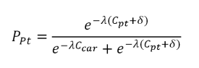
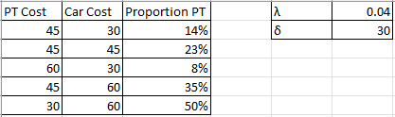
Binary Logit Model
P_{pt} – Proportion Public Transport
C_{pt} – Cost of public transport (generalised minutes)
C_{car} – Car cost (generalised minutes)
λ – Sensitivity factor (0.04 standard value)
δ – Inconvenience and crowding penalty (recommend 20-40 minutes standard value

Slide 19
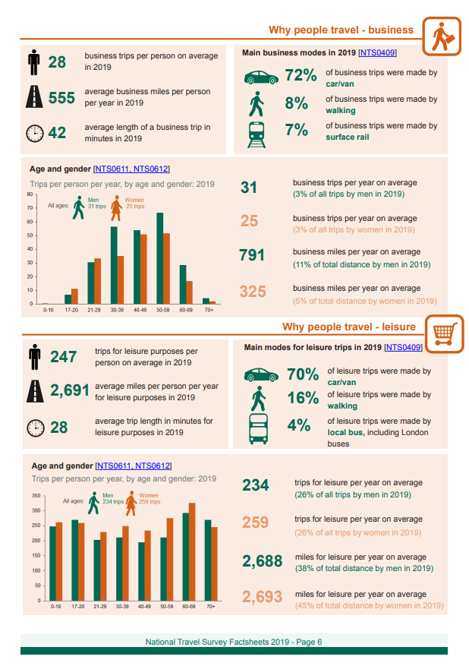
Draft Methodology (4)
Could focus on just commuters or use WebTRIS (National Highways data) or NTS (National Travel Survey) to factor to all trip types. Compare different methods, limitations of any assumptions. – how does NTS align with Census data. NTS is a rich dataset in itself – could undertake a range of statistical analysis around mode, purpose, by time of day / distance and mode etc.

Slide 20
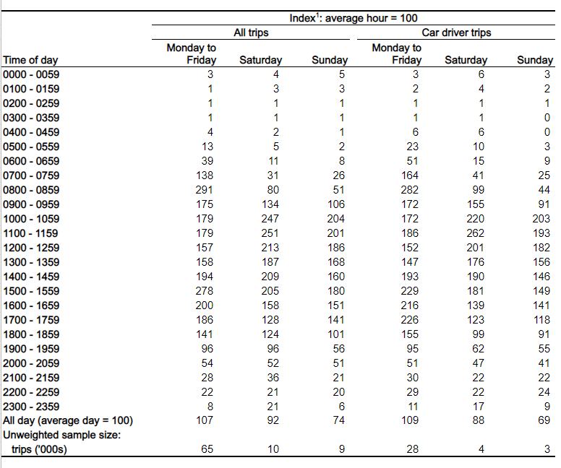
Draft Methodology (5)
Distribute the car trips on the motorway by time of day – NTS provides trip start time and trip purposes for this.

Slide 21
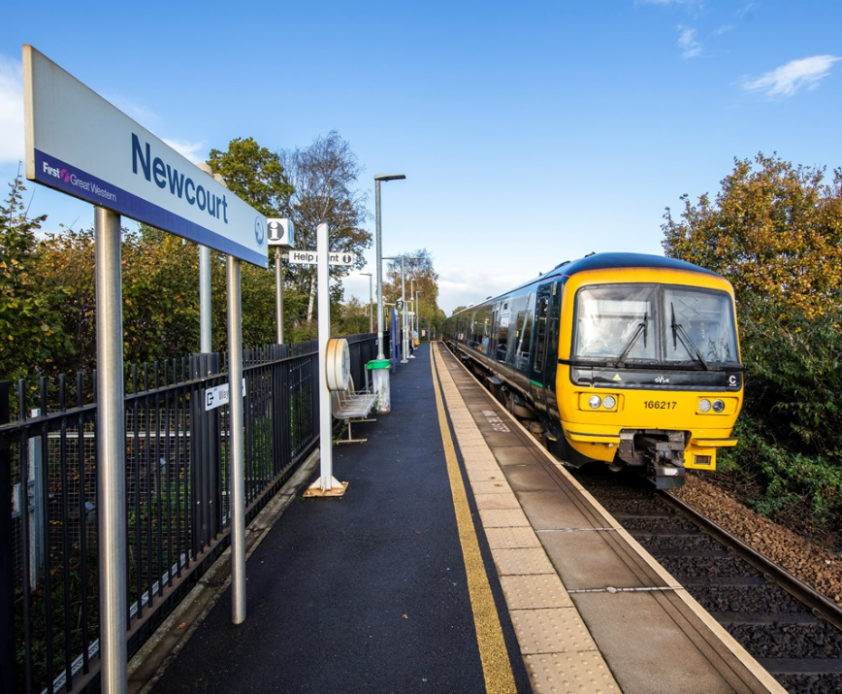
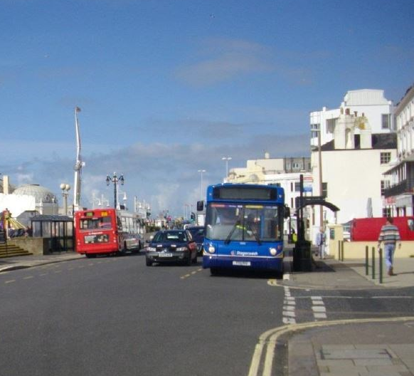
Draft Methodology (6)
Look at some what ifs for public transport on the motorway – how frequent, what size vehicles, etc if looking to intercept all car trips between towns – how would this impact on carbon (operational carbon data – cars removed, buses introduced). Could use DEFRA Emissions Factor Toolkit (EFT) or DfT Vehicle Emissions Carbon Tool (VECAT)
EFT
https://laqm.defra.gov.uk/air-quality/air-quality-assessment/emissions-factors-toolkit/
VECAT
https://www.gov.uk/government/publications/vehicle-emissions-carbon-tool-vecat#:~:text=The%20vehicle%20emissions%20carbon%20tool,part%20of%20a%20business%20case

Slide 22
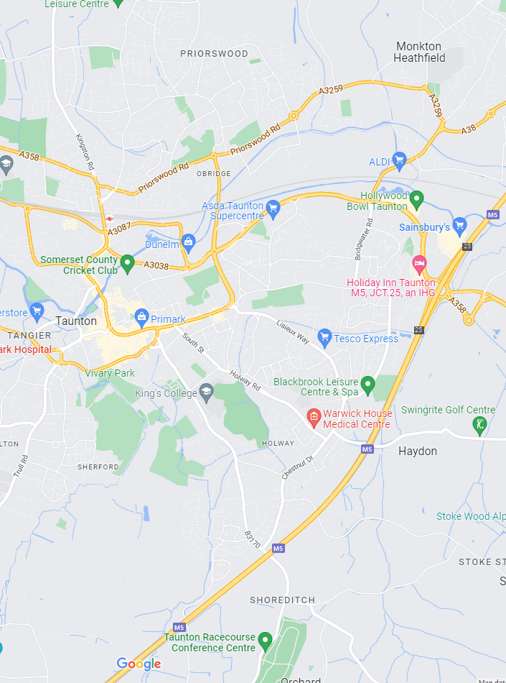
Draft Methodology (7)
Look at one or two towns in more detail – what feeder services would you need to get people to / from the motorway junctions.

Slide 23
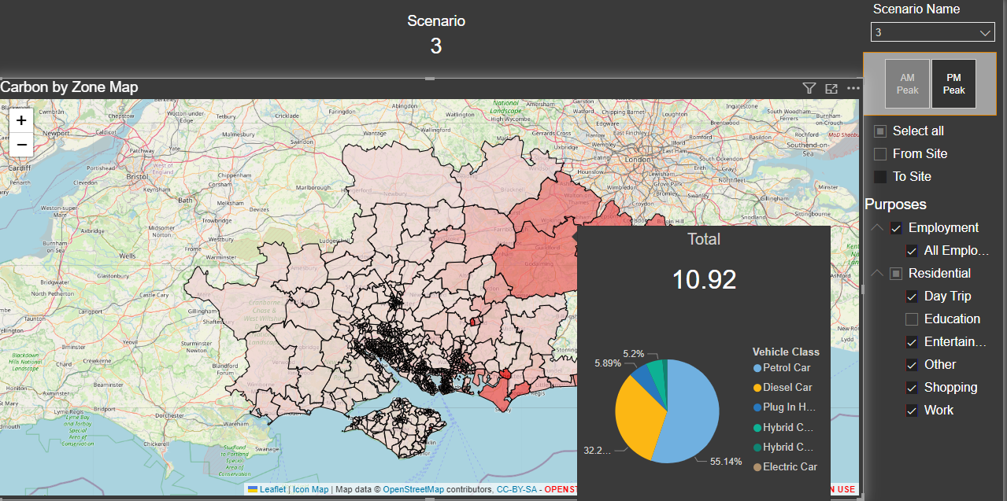
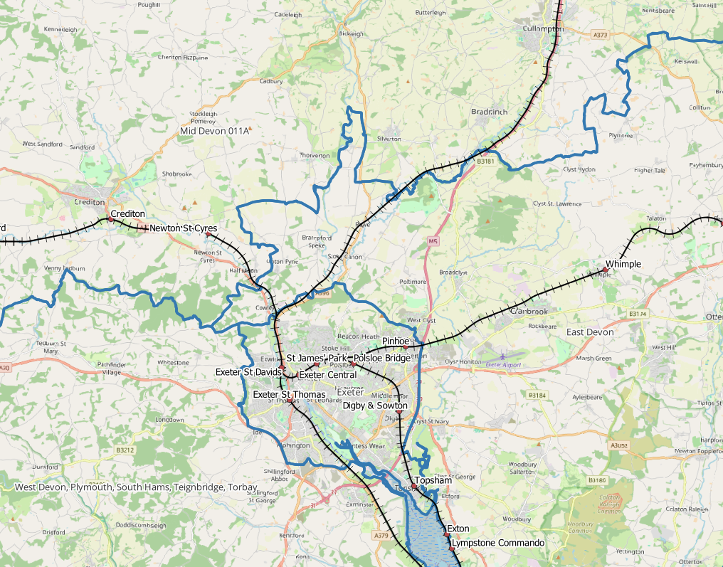
Draft Methodology (8)
Present findings in a visual way such as:
PowerBI
R / Python
GIS

